Slide 1
Module 1
Deploying Exchange Server 2016 and 2019
Notes:
Presentation: 50 minutes
Lab: 60 minutes
After completing this module, students will be able to:
Describe the features and functionality of Microsoft Exchange Server 2016.
Describe the requirements and options for deploying Exchange Server 2016.
Required materials
To teach this module, you need the Microsoft PowerPoint file 20345-1A_01.pptx.
Preparation tasks
To prepare for this module, you should:
Read all of this module’s materials.
Practice performing the demonstrations and labs.
Work through the Module Review and Takeaways section to determine how you will use the information to reinforce student learning and promote knowledge transfer to on-the-job performance.
As you prepare for this class, it is imperative that you complete the labs yourself. This gives you an understanding of how the labs work, as well as the concepts that each lab covers. This enables you to provide meaningful hints to students who might have issues while working in the labs. Furthermore, it will help guide your lecture to ensure that you discuss the concepts that the labs cover.
20345-1A
1: Deploying Exchange Server 2016

Slide 2
Module Overview
Overview of Exchange Server 2016/2019 Requirements and deployment options for Exchange Server
Notes:
This is an introductory module. Do not spend too much time on topics where new features are described because later modules will discuss most of these features in detail.
20345-1A
1: Deploying Exchange Server 2016

Slide 3
Lesson 1: Overview of Exchange Server 2016/2019
Role architecture in Exchange Server 2016/2019
What’s new in Exchange 2016/2019 for Exchange 2013 administrators
Discontinued and deemphasized features in Exchange Server 2016/2019
On-Premises Exchange Server vs. Exchange Online
Notes:
At the beginning of this lesson, ask students about their current Exchange environment. Based on their answers, you can adjust the time that you will spend on topics for Exchange Server 2013 administrators and Exchange Server 2010 administrators.
Question
What is the most important architectural change in Exchange Server 2016 and what benefits does this change provide?
Answer
The most important architectural change is that all key functionalities including the Mailbox server role, Client Access server role, Hub Transport server role, and Unified Messaging server role are now located on the Mailbox server. This architectural change provides the following benefits:
Fewer physical or virtual servers
Simplified management
Better scalability and reliability
Question
Did you consider implementing Exchange Online instead of Exchange Server on-premises? Why or why not?
Answer
Answers might vary.
20345-1A
1: Deploying Exchange Server 2016
(More notes on the next slide)

Slide 4
Role architecture in Exchange Server 2016/2019
Exchange Server 2016 and 2019 consolidates all roles on the Mailbox server, except the Edge Transport server role
Mailbox server now hosts both front-end and back-end client access services
All client requests, except the Unified Messaging requests, are proxied to back-end services on the Mailbox server
Role consolidation provides several benefits in cost, management, and scalability
Notes:
Explain the new, simplified role architecture in Exchange Server 2016. Emphasize that the biggest change from Exchange Server 2013 is the integration of client access services with the Mailbox server. Discuss the benefits that role consolidation provides.
20345-1A
1: Deploying Exchange Server 2016

Slide 5
Role changes in Exchange Server 2019
The Unified Messaging Role service is no longer available in Exchange Server 2019
Customers using UM functionality are required to use alternative solution
Alternative solutions include
Azure Cloud Voice Mail
3rd Party solutions
UM enabled mailboxes are UM disabled as soon as they are moved to an Exchange Server 2019

Slide 6
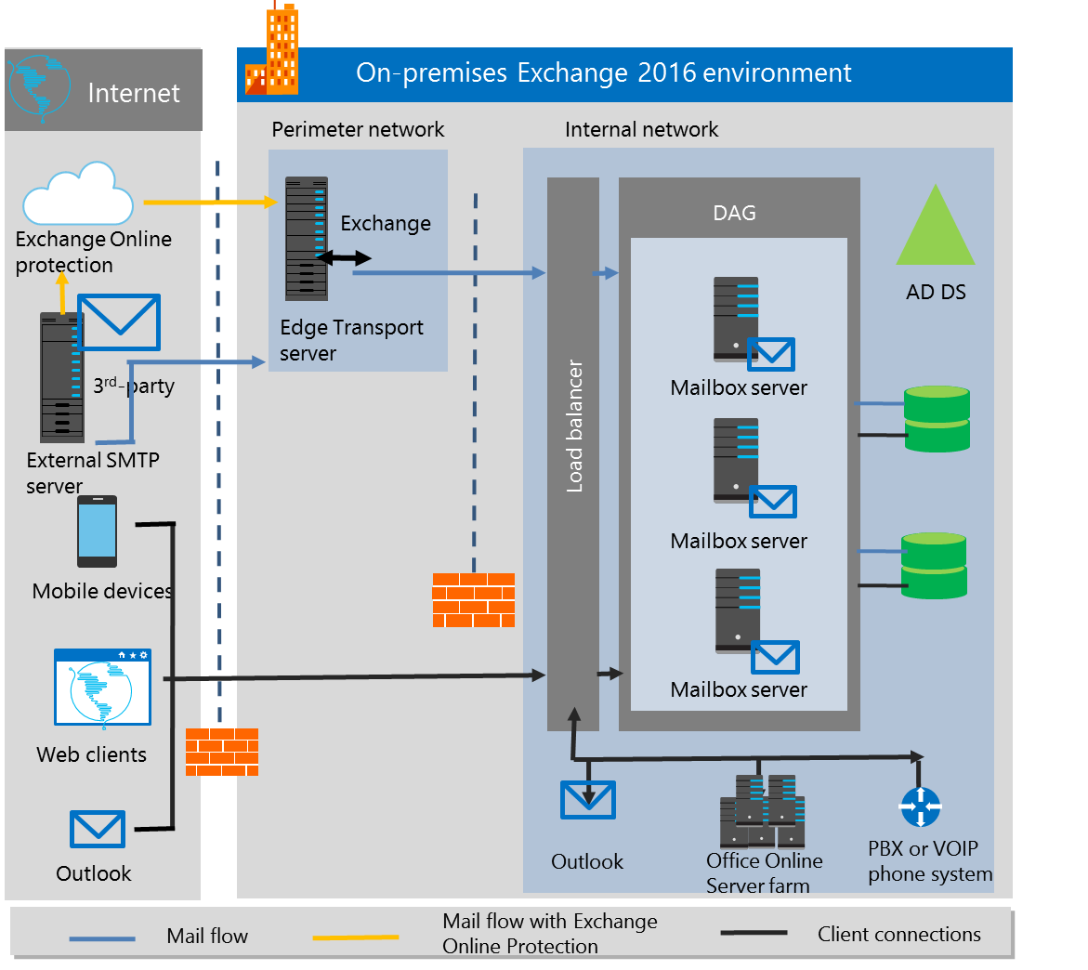
Role architecture in Exchange Server 2016/2019 (continued)
Exchange 2016 only
Notes:
Use the diagram on the slide to explain how Exchange server role architecture now looks.
20345-1A
1: Deploying Exchange Server 2016

Slide 7
What’s new in Exchange 2016 for Exchange 2013 administrators
Important changes from Exchange Server 2013 to Exchange Server 2016 include:
Client Access server is no longer a separate server role
Client traffic proxying from Exchange Server 2013 to Exchange Server 2016
Updated and optimized Outlook on the web interface
MAPI over HTTP is the default client protocol
Outlook on the Web users can link and share documents that are stored in OneDrive for Business or stored in SharePoint Server
Users can now edit Word, Excel, or PowerPoint files within email message (Office Online Server is required)
Notes:
Discuss the most important changes and enhancements in Exchange Server 2016 from the perspective of Exchange Server 2013 administrators. Note that there are two slides in this topic.
20345-1A
1: Deploying Exchange Server 2016

Slide 8
What’s new in Exchange 2016 for Exchange 2013 administrators (continued)
Hybrid Configuration Wizard is now a cloud-based application (similar to click-and-run)
More seamless redirection of ActiveSync clients to Office 365
New templates, conditions, and actions when you create DLP policies
In-Place eDiscovery and In-Place Hold support for Public Folders
Redesigned search infrastructure
Notes:
20345-1A
1: Deploying Exchange Server 2016

Slide 9
What’s new in Exchange 2019 for Exchange 2013/2016 administrators
Important changes from Exchange Server 2013/2016 to Exchange Server 2019 include:
Support for installations on Windows Server Core (recommended)
TLS 1.2 enabled by default (others disabled)
Updated and optimized Outlook on the web interface
Extended out of office experience (OWA only)
Client Access rules give administrators control over client connections (currently only ECP and PowerShell)
Notes:
Discuss the most important changes and enhancements in Exchange Server 2016 from the perspective of Exchange Server 2013 administrators. Note that there are two slides in this topic.
20345-1A
1: Deploying Exchange Server 2016

Slide 10
What’s new in Exchange 2019 for Exchange 2013/2016 administrators
Important changes from Exchange Server 2013/2016 to Exchange Server 2019 include:
CMDLets for Calender control
Index is based on Bing technology (Big Funnel)
Support for tiered storage for databases
Support for Email Address Internationalization
Changes in code compilation improve HW support
Notes:
Discuss the most important changes and enhancements in Exchange Server 2016 from the perspective of Exchange Server 2013 administrators. Note that there are two slides in this topic.
20345-1A
1: Deploying Exchange Server 2016

Slide 11
Discontinued and deemphasized features in Exchange Server 2016
Features from Exchange Server 2010 that are discontinued in Exchange Server 2016:
The Unified Messaging server role
The Hub Transport server role
Exchange Management Console and Exchange Control Panel
Support for Outlook 2003 and RPC/TCP client access
Spell check in Outlook Web App
Custom date on a message flag and customizable filtered views in OWA
Anti-spam agent management in the EMC
Managed folders
Notes:
Discuss what is discontinued and what has been deemphasized in Exchange Server 2016 when comparing to Exchange Server 2013.
20345-1A
1: Deploying Exchange Server 2016

Slide 12
Discontinued and deemphasized features in Exchange Server 2016 (continued)
Discontinued features from Exchange Server 2013:
Client Access Server
MAPI/CDO library
Deemphasized features from Exchange Server 2013:
RPC over HTTP
Database availability group support for failover cluster administrative access points
Third-party replication APIs
Notes:
20345-1A
1: Deploying Exchange Server 2016

Slide 13
Discontinued and deemphasized features in Exchange Server 2019
Discontinued features from Exchange Server 2016:
Unified Messaging functionality
Database availability group support for failover cluster administrative access points
Third-party replication APIs
Deemphasized features from Exchange Server 2016:
RPC over HTTP – Outlook Anywhere
Notes:
20345-1A
1: Deploying Exchange Server 2016

Slide 14
On-Premises Exchange Server vs. Exchange Online
With Exchange Server on-premises:
You maintain a local installation of Exchange Server in your data center
You perform maintenance, upgrades, and customization
With Exchange Online:
All of the mailboxes are hosted in the cloud
You do not host any Exchange servers in your data center
You receive automatic upgrades to the most recent technology
Notes:
Discuss most important differences between Exchange Server on-premises and Exchange Online.
20345-1A
1: Deploying Exchange Server 2016

Slide 15
Lesson 2: Requirements and deployment options for Exchange Server 2016/2019
AD DS and Exchange Server Integration DNS server requirements for Exchange Server 2016/2019 Software requirements for Exchange Server 2016/2019 Hardware sizing for Exchange Server 2016/2019 Infrastructure requirements for Exchange Server 2016/2019 Preparing AD DS for Exchange Server 2016/2019 installation Virtualizing Exchange Server 2016/2019 and Exchange Server in Azure Exchange Server Setup Wizard Exchange Server post-installation tasks Deployment options for Exchange Server 2016/2019
Notes:
Provide a brief overview of the lesson content.
Question
In which Active Directory partition does Exchange Server store its configuration?
( )Option 1: Application partition
( )Option 2: Domain Partition
( )Option 3: Schema Partition
( )Option 4: Configuration Partition
( )Option 5: Global catalog
Answer
(√)Option 5: Global catalog
Question
What tool should you use to determine the hardware sizing for a Mailbox server?
Answer
You should use the Exchange Server Role Requirements Calculator.
20345-1A
1: Deploying Exchange Server 2016

Slide 16







AD DS and Exchange Server integration
Exchange organization and
Active Directory forest: one-to-one relationship
Forests
Exchange object classes
and attributes
Schema
Exchange configuration
Configuration
Exchange recipients
Domain
Exchange object attributes
for mail-enabled and
mailbox-enabled objects
Global catalog
Notes:
Discuss Active Directory partitions. Remind the students about the purpose of each Active Directory Domain System (AD DS) partition, and then discuss how Exchange Server integrates in each partition.
20345-1A
1: Deploying Exchange Server 2016

Slide 17
Software requirements for Exchange Server 2016
Software requirements for Exchange Server 2016 are:
Windows Server 2012 (R2) Standard or Datacenter
Windows Server 2016 (CU4 or later)
Microsoft .NET Framework 4.7.1
VC++ 2013 Runtime (CU10 or higer)
Windows Management Framework 4.0 or later
RSAT for AD DS
Microsoft Unified Communications Managed API 4.0, Core Runtime 64-bit
Internet Information Services
https://docs.microsoft.com/en-us/Exchange/plan-and-deploy/prerequisites?view=exchserver-2016
Notes:
Discuss necessary software components required for Exchange Server 2016 installation.
20345-1A
1: Deploying Exchange Server 2016

Slide 18
Hardware sizing for Exchange Server 2016
General hardware requirements are:
Processor:
Intel 64-bit architecture
AMD64 architecture
Memory:
8 GB is recommended minimum
Additional memory is required based on server load
192 GB maximum supported
Disk:
30 GB free disk space for Exchange Server files
200 MB free on the system drive
Additional space for mailbox storage
NTFS file system on system drive, ReFS on data drives
Notes:
It is important to explain to the students that hardware configuration planning for Exchange Server is much more involved than simply following the minimum and recommended hardware specifications. Discuss how several factors can influence Exchange Server hardware configurations.
20345-1A
1: Deploying Exchange Server 2016

Slide 19
Software requirements for Exchange Server 2019
Software requirements for Exchange Server 2019 are:
Windows Server 2019
Microsoft .NET Framework 4.7.2
VC++ 2012 Runtime
VC++ 2013 Runtime
Windows Management Framework 5.0 or later
RSAT for AD DS
Microsoft Unified Communications Managed API 4.0, Core Runtime 64-bit
Internet Information Services
https://docs.microsoft.com/en-us/Exchange/plan-and-deploy/prerequisites?view=exchserver-2019
Notes:
Discuss necessary software components required for Exchange Server 2016 installation.
20345-1A
1: Deploying Exchange Server 2016

Slide 20
Hardware sizing for Exchange Server 2019
General hardware requirements are:
Processor:
Intel 64-bit architecture
AMD64 architecture
Memory:
128 GB is recommended minimum
256 GB maximum supported
Disk:
30 GB free disk space for Exchange Server files
200 MB free on the system drive
Additional space for mailbox storage
NTFS file system on system drive, ReFS on data drives
Notes:
It is important to explain to the students that hardware configuration planning for Exchange Server is much more involved than simply following the minimum and recommended hardware specifications. Discuss how several factors can influence Exchange Server hardware configurations.
20345-1A
1: Deploying Exchange Server 2016

Slide 21
Exchange Server 2019 on Windows Server 2022
Requires Exchange Server 2019 CU12
No inplace upgrade of OS supported
Currently no TLS 1.3 support
ETA for TLS 1.3 support is 2023

Slide 22


Infrastructure requirements for Exchange Server 2016
Infrastructure component | Requirements
Active Directory | Domain and forest functional levels must be at least Windows Server 2008 R2 Domain Controllers supported: Windows Server 2008 R2 - 2019
DNS | Must be configured to enable domain controller and global catalog server name resolution
Notes:
Discuss infrastructure requirements for Exchange Server 2016 deployment.
20345-1A
1: Deploying Exchange Server 2016

Slide 23
Infrastructure requirements for Exchange Server 2019
Infrastructure component | Requirements
Active Directory | Domain and forest functional levels must be at least Windows Server 2012 R2 Domain Controllers supported: Windows Server 2012 R2 - 2019
DNS | Must be configured to enable domain controller and global catalog server name resolution
Notes:
Discuss infrastructure requirements for Exchange Server 2016 deployment.
20345-1A
1: Deploying Exchange Server 2016

Slide 24
Preparing AD DS for Exchange Server installation
Setup parameter | Description
/PrepareSchema | Prepares the schema for the Exchange Server installation
/PrepareAD /OrganizationName: ”organizationname” | Prepares the global Exchange Server objects Creates the Exchange Server universal security groups in the root domain Prepares the current domain
/PrepareDomain /PrepareDomain domainname /PrepareAllDomains | Prepares the domain where Exchange Server recipients are located
Notes:
Discuss how you should prepare the Active Directory infrastructure for Exchange Server installation. Verify that the students understand how Exchange Server setup modifies the schema partition, configuration partition, and domain partition in AD DS.
20345-1A
1: Deploying Exchange Server 2016

Slide 25
Virtualizing Exchange Server and Exchange Server in Azure
You can deploy all Exchange Server roles on virtual machines running on a supported virtualization platform
Do not use snapshots with Exchange Server virtual machines
You can combine high-availability features for Mailbox servers in Exchange Server with highly available virtual machines
Design virtual hardware by using the same criteria that you use for your physical hardware
Notes:
Discuss Exchange Server virtualization. Be sure to explain that Exchange Server virtualization is now fully supported, with a few constraints, as described in this topic. Emphasize that in most scenarios, there is no longer many reasons to consider running Exchange Server on a physical computer.
To familiarize yourself with the preferred architecture from Microsoft, refer to The Exchange 2016 Preferred Architecture: http://aka.ms/axf7z0
20345-1A
1: Deploying Exchange Server 2016

Slide 26
Virtualizing Exchange Server and Exchange Server in Azure (continued)
Azure IaaS platform now fully supports virtual machines with Exchange ServerMust use
Must use Azure Premium storage
Understand difference between Exchange on Azure and Exchange Online
Some common scenarios for running Exchange on Azure:
Deploying Exchange Server test environment
Deploying Exchange hybrid servers
Deploying DAG witness server
Notes:
Discuss how and when you should run Exchange Server in Azure IaaS. First, ensure that students understand the difference between this approach and Exchange Online. Next, emphasize that from a cost perspective, Exchange Server in IaaS might not be an optimal solution.
20345-1A
1: Deploying Exchange Server 2016

Slide 27
Exchange Server Setup Wizard
Installation steps in the Exchange Server Setup Wizard include the following pages:
Check for Updates
License Agreement
Recommended Settings
Server Role Selection
Installation Space and Location
Exchange Organization
Malware Protection Settings
Readiness Checks
Notes:
Provide a brief overview of Exchange Server 2016 Setup Wizard.
20345-1A
1: Deploying Exchange Server 2016

Slide 28
Exchange Server post-installation tasks
Verify services functionality
Secure your Exchange Server:
Restrict physical access
Restrict communication
Reduce the attack surface
Restrict permissions
Install and configure additional software (optional):
Antivirus software
Anti-spam software
Backup software
Monitoring tools and agents
Notes:
Discuss the tasks that you should perform after you complete Exchange Server 2016 installation.
20345-1A
1: Deploying Exchange Server 2016

Slide 29
Deployment options for Exchange Server 2016/2019
Exchange Server versions:
Standard (allows mounting up to 5 mailbox databases)
Enterprise (allows mounting up to 100 mailbox databases)
Exchange Server CAL:
Standard
Enterprise
Deployment scenarios:
Single-server deployment
Multiple-server deployment
Hybrid deployment
Notes:
Discuss Exchange Server 2016 versions and deployment types. Make sure that the students understand the advantages and disadvantages of each deployment type.
20345-1A
1: Deploying Exchange Server 2016

Slide 30
Lab1: Deploying Exchange Server
LAB 1: Installation
Notes:
Make sure that the students start the B version of the LON-DC1 and LON-EXCH machines, because other virtual machines already have Exchange Server 2016 installed. After students complete this lab, have them delete the B versions of the virtual machines so they can avoid confusion in later labs.
Exercise 1: Evaluating requirements and prerequisites for an Exchange Server 2016 installation
The Active Directory administrators at A. Datum Corporation have prepared a test AD DS environment for an Exchange Server 2016 deployment. The server administration team has deployed a Windows Server 2012 R2 server that you can use to deploy the first Exchange Server 2016 server in the test organization. You need to verify that the AD DS environment and DNS meet all the prerequisites for installing Exchange Server 2016.
Exercise 2: Deploying Exchange Server 2016
After evaluating the Exchange Server 2016 requirements, you are ready to start deployment. First, you will prepare AD DS, and then install Exchange Server 2016 on a single server.
20345-1A
1: Deploying Exchange Server 2016

Slide 31
Module Review and Takeaways
Best Practice
Common Issues and Troubleshooting Tips
Review Question Tools
Notes:
Best Practice
Always plan for Exchange server resources before starting an installation process.
Monitor Exchange Server services and logs with monitoring software such as Operations Manager.
Learn how to use Exchange Management Shell.
To avoid restarts, install the Windows Server roles and features that are required for Exchange Server 2016, prior to installing Exchange Server.
Common Issues and Troubleshooting Tips
Common Issue: Schema extension fails
Troubleshooting Tip: Verify that you have the appropriate permissions to modify AD DS.
Ensure that you have provided all necessary switches.
Review Question
Question
How can you configure high availability options for Exchange Online? How does it differ from Exchange deployed on-premises?
Answer
You do not configure any options for Exchange Online high availability because it is provided and managed by Microsoft. On an Exchange server that is locally deployed, you must configure two or more servers to achieve high availability.
Tools
Exchange Server setup wizard
Exchange Server Role Requirements Calculator
20345-1A
1: Deploying Exchange Server 2016

